Slide 1

Message from Chairman Wan Gang
我谨代表万钢主席预祝本次国际会议取得圆满成功！
面对复杂多变的内部、外部环境和百年未遇之大变革，全球汽车产业应紧密合作、共克时艰、面向未来，主动拥抱新一轮科技革命和产业变革，化危为机，加快推进“电动化、智能化、共享化”转型发展，为建设清洁美丽世界、推动世界创新、绿色、可持续发展作出更大贡献。
The world is facing the complex and fast-changing internal and external situations and witnessing the unseen transformation in a century. To convert the challenges into opportunities, global auto industry should embrace the new wave of technology revolution with joint efforts, accelerate the development of electrification, intelligence and mobility-sharing, pave the way to a clean and beautiful future by promoting innovative, green and sustainable development.
万 钢
Wan Gang
全国政协副主席、中国科学技术协会主席
Vice Chairman of the Chinese People's Political Consultative Conference
Chairman of China Association for Science and Technology

Slide 2

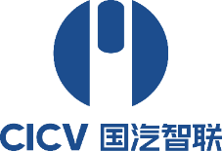
New Energy and Intelligent Connected Vehicle
Development in China
Keqiang LI
Professor, School of Vehicle and Mobility, Tsinghua University
Chief Scientist, China National Innovation Center for Intelligent and Connected Vehicles
Chairman of Expert Committee, CAICV (China Industry Innovation Alliance for ICV)
June 24, 2021
Notes:
要求15分钟

Slide 3
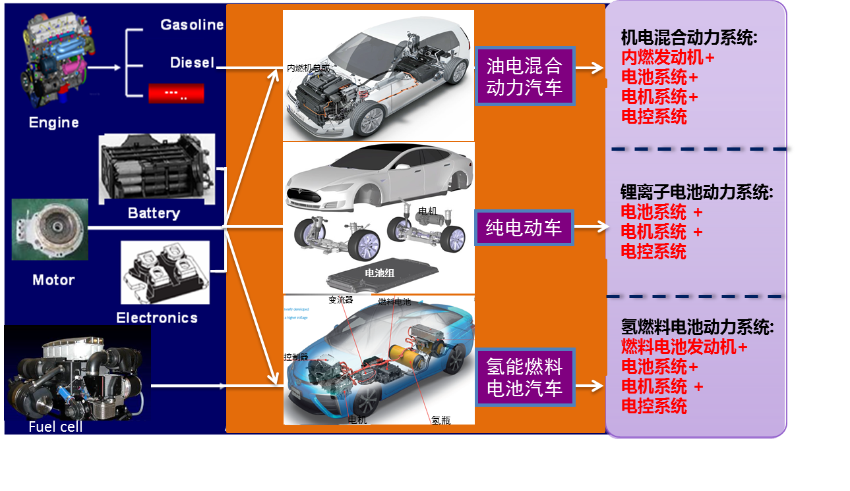
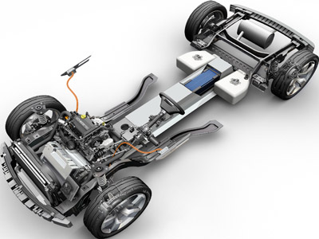
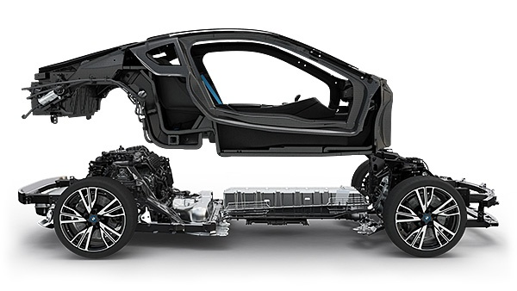
NEV Research and Development Strategy
Platforms Adopting Various Electric Powertrain Technologies on Common Systems
Hybrid powertrain
Engine + Transmission +
Battery +
Motor +
Electric control
在汽车发展的初期，曾经出现过汽车动力的多元化，100多年后的今天，又出现了多元化。 国外专家估计，主流格局在2030年后会看出端倪，其中，中国的选择将发挥重大作用。
HEV
Li-ion battery powertrain
Battery +
Motor +
Electric control
BEV
Hydrogen fuel cell powertrain
Fuel cell +
Battery +
Motor +
Electric control
HFCV

Slide 4
Fast Growing NEV Market in China
NEV annual sales: >1 million in recent 3 years; NEV market share: over 5% in 2019 and 2020
NEV market: 75% BEV, 25% PHEV
Cumulatively, 5M NEVs on the road, accounting for 48% of global NEV population
NEV Sales and Market Penetration Rate
NEV Population in China

Slide 5
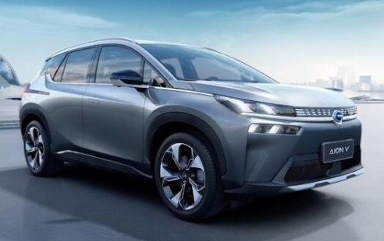
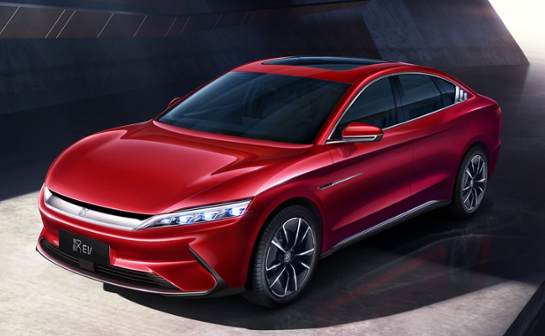
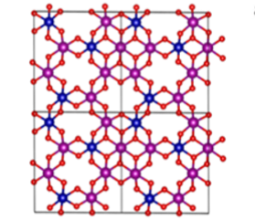
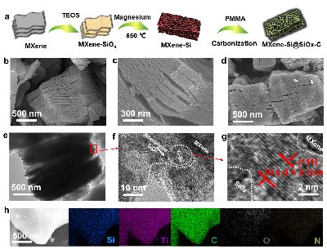
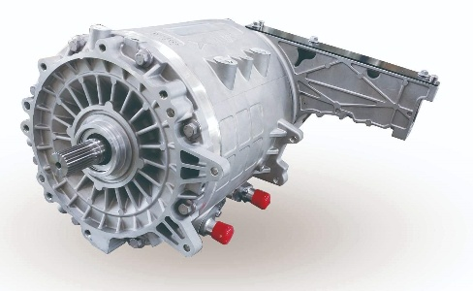
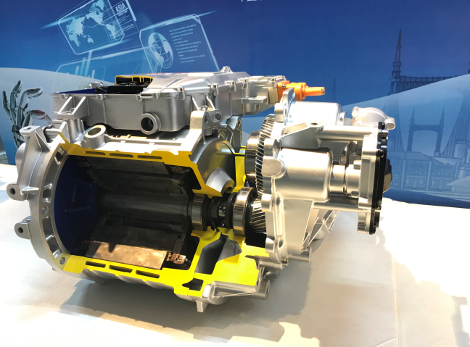
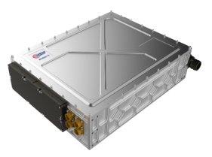
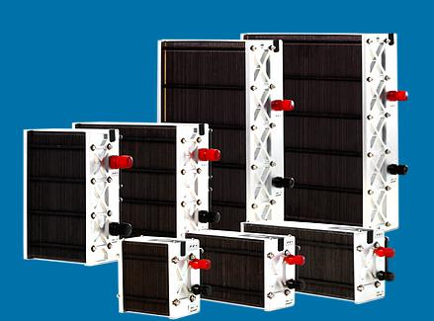
Progress of Key NEV Technologies
New battery integration: blade battery, CTP (cell-to-pack)
Next Generation Battery: Energy density >400Wh/g;
rich lithium manganese base new anode materials: 400mAh/g
Si/C negative electrode materials: 1600mAh/g
EV-dedicated Platform: all-aluminum, lightweight
Integration
Battery
Power density of the drive motor exceeds 5kW/kg
“three-in-one” drive unit：Efficiency reaches 97%, noise level in full operation less than 80dB
Power density of the galvanic pile with the bipolar metal plate reaches 4.2kW/L
Power density of the galvanic pile with the graphite bipolar plate amounts to 2.2 kW/L
Motor
Fuel Cell

Slide 6














China Localized ICV Solution
Connected-Operation System of Systems
Definition of Localized ICV Solution
  Comply with Chinese Infrastructure Standards
  Including standards of road infrastructure, map data, V2X communication, and transportation, etc.
  2.Comply with Chinese Connected-Operation Standards
  Including standards of ICV access, supervision of connected operation, information security, etc.
  3.Comply with new standardized Architecture of Automotive Products in China
  Including standards of intelligent terminal, communication system, cloud platform, gateways, ADAS, ADS, etc.
Intelligent Infrastructure
Cybersecurity Management
Central Cloud
HD Map
Positioning & Time Service
Edge Cloud
Edge Cloud
C-V2X
C-V2X
The paradigm of China’s Localized ICV Solution
  Through architecting localized solution of ICV Cyber-Physical System with the considerations of the combined characteristics of automation and connection, realizing China’s ICV Complex, which is the embodiment of “five fundamental platforms,” underlining the concept of “Human-Vehicle-Road-Cloud.”
Camera/Milimeter/LiDar
Chips / Computing Platform / Novel terminal
Vehicle with New System Architecture
  The Architecture of Localized Solution for ICV Complex

Slide 7
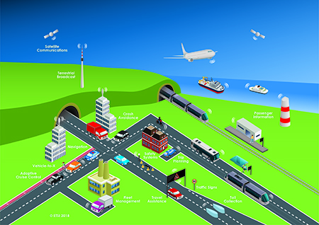




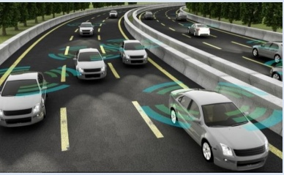






Top Level Design of ICV Architecture
ICV is a typical application of CPS in the automotive transportation system of systems.
ICV is a typical complex CPS that deeply integrates various systems of automotive, transportation, and ICT
ICV CPS
Big Data Computation Based on Real Data
Safety, energy-saving, and efficient mobility ecology-oriented coordination/collaboration application (cloud)
ITS
Digitalization of physical space - intelligent data processing and basic database (cloud)
Standardized Interconnection System
High Speed & Low Latency Communication
Standardized Interconnection System
Physical Space
To meet the complex requirements of interdisciplinary, cross-industrial development and tackle the challenges brought by regional properties, it is imperative to construct a state-of-the-art ICV CPS.
ICV

Slide 8
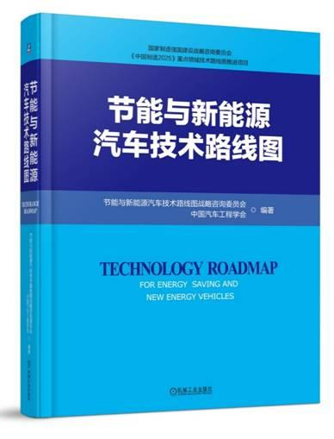
Deep Fusion Between Intelligence and Connection for ICV
China was the first country to classify the levels of intelligence and connection fusion; the technology roadmap is under continuous revision and improvement.
In 2016, release of “The Technology Roadmap for ICVs”
first time to classify the levels of intelligence and connection fusion
continuous revision and update
Connected Level | Name | Definition | Typical information | Transmission needs | Typical scenes | Vehicle control body
1 | Connected Auxiliary Information Interaction | Acquire auxiliary information such as navigation, and upload data such as a vehicle running and driver’s operations, based on the vehicle-road and vehicle-background communications. | Maps, traffic flow, traffic signs, fuel consumption, mileage, etc. | Low requirements for transmission timeliness and reliability. | Traffic information reminder, vehicle-mounted information service, weather information reminder, emergency call service, etc. | Human
2 | Connected Collaborative Perception | Acquire real-time traffic environment information surrounding the vehicle based on vehicle-vehicle, vehicle-road, vehicle-human, vehicle-background communications, and integrate it with the perceptual information of vehicle-mounted sensors as the input of auto-vehicle’s decision and control system. | Digital information such as locations of surrounding vehicles/pedestrians/non-motor vehicles, signal light phase, road early warning, etc. | High requirements for transmission timeliness and reliability. | Early warning for wet and slippery roads, traffic accidents, and emergency braking, giving way to special vehicles, etc. | Human or system
3 | Connected Collaborative Decision and Control | Acquire the surrounding traffic environment information and vehicle decision information based on vehicle-vehicle, vehicle-road, vehicle-cloud communications; integrate with the information of traffic participants such as vehicle-vehicle and vehicle-road; and achieve intelligent collaboration, thus realizing the collaborative decision and control between traffic participants. | Collaborative perception, decision, and control information among vehicle-vehicle, vehicle-road, and vehicle-cloud. | Highest requirements for transmission timeliness and reliability. | Guiding running speed, vehicle spacing, lane selection, collaborative formation, passing through intersections, ramp confluence, etc. | Human or system

Slide 9


















Five Platforms Supporting New ICV Deployment
Five Fundamental Platforms: Computing Platform, Cloud Control Platform, Dynamic HD Map Platform, Cybersecurity Platform, Intelligent Terminal Platform
Industrial Chain of Conventional Automotive Electronics
Industrial Chain of Automated Driving Electronics
ICT
OEM
Tier1
Map
CC
OEM
OEM
CICV
OEM
OEM
Base Computing Platform Company
Tier1
Output
Computing Platform
APP
Customized Hardware
Central Cloud
Tier1
ECU H/S
。。。
Cybersecurity
Tier1.5
Processor Heterogeneous Technology
HD Map
OS
Basic Functions
Heterogeneous Distributed Hardware Architecture
Base Computing Platform
Edge Cloud
Basic Software Architecture
AI Application
Hardware Acceleration
Tier2
.......
State Governance
Data Sharing
New Crossover Technologies
AD-OS
Chip
Core system
IP
Tier2
......
Chip
Core
IP
Notes:
这页把五大平台都标注一下

Slide 10
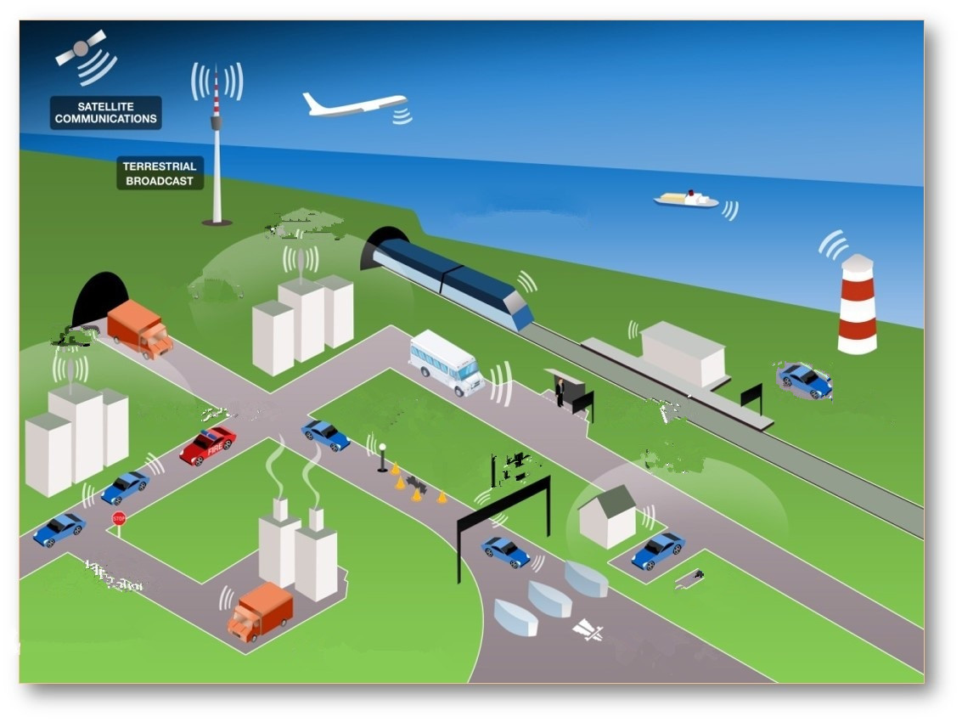


ICV Solution Contributes to Future Low-carbon Mobility Ecosystem
  Future Smart Mobility Ecosystem based on ICV with New Generation AI
Satellite Communications
Roadbase Communications
Cloud Control Intelligence
Swarm Intelligence
Big Data Driven Swarm Decision-making
Unstructured Road Smart Driving
Urban Road Smart Driving
Human-Vehicle-Road Interaction Recognition
All-Element Connected Perception
Human-Vehicle-Road Collaborated Control
Highway Smart Driving
Hybrid Intelligence

Slide 11
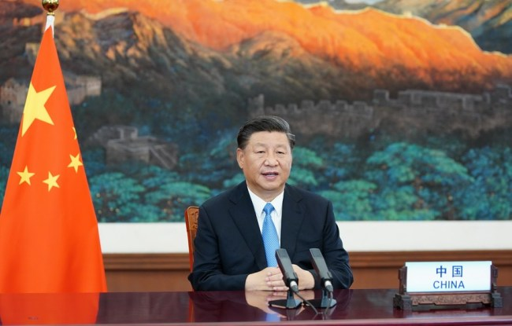
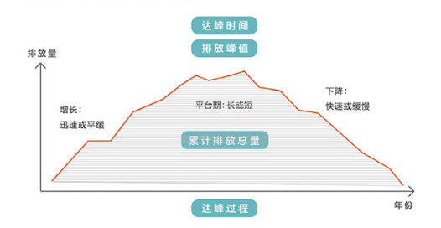
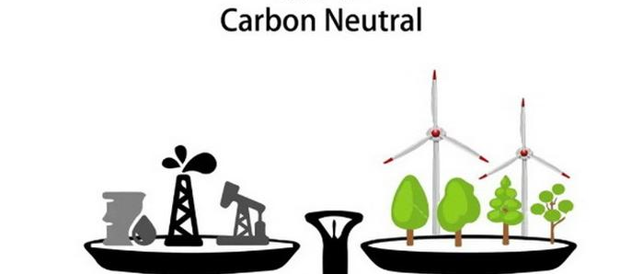
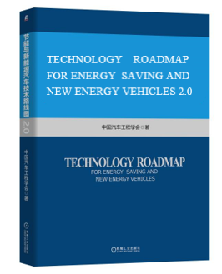
Timelines Towards Carbon Neutrality in Auto Industry in Technology Roadmap 2.0
China is willing to contribute more to the fight against climate change, as it aims to bring carbon emissions to a peak by 2030 and achieve carbon neutrality by 2060 with more aggressive policies and measures.
—— Chinese President Xi Jinping
2030
2060
“Technology Roadmap for Energy Saving and New Energy Vehicles V2.0”
  2028: Achieve carbon emission peak in auto industry, 2 years ahead of the national carbon emission commitment
  2035: Reduce carbon emission more than 20% of peak value
  2050: zero carbon emission
  2060: carbon neutrality
Notes:
《节能与新能源汽车技术路线图2.0》提出：
2028年：汽车产业实现碳达峰，先于国家碳减排承诺
2035年，碳排放总量较峰值下降20%以上
我国汽车产业将于2050年实现接近于零的碳排放，2060年之前实现碳中和。

Slide 12
The End
Thank You for Your Attention !

